Slide 1
JNCIS-ENT
Layer 2 security and loop prevention

Slide 2
DHCP Snooping and Dynamic ARP Inspection
9
Layer 2 / 3 security

Slide 3
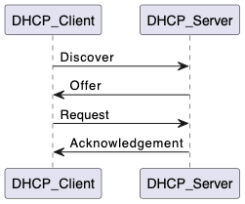
DHCP Review
DHCP (Dynamic Host Configuration protocol) is generally responsible for assigning IP addresses to devices within the enterprise.
DHCP works in a client-server model, with the client requesting an IP address from the server and the server allocating and acknowledging the assignment.

Slide 4
What is DHCP Snooping
DHCP Snooping allows for a switch to have an authoritative source of information to know what IP address is assigned to each MAC addresses
A switch with DHCP Snooping enabled will listen for DHCP messages originating from a trusted to server to learn what IP address is assigned to each MAC address
DHCP Snooping inspects the Client IP Address and Client Hardware Address fields of the DHCP acknowledgment to learn the assigned IP to MAC mapping
DHCP-ACK
192.168.2.231 is assigned to
a8:f8:12:5e:32:4c

Slide 5
DHCP Snooping configuration
user@switch1> show configuration vlans default
vlan-id 1;
forwarding-options {
dhcp-security {
group trusted {
overrides {
trusted;
}
interface ge-0/0/0;
}
group untrusted {
interface ge-0/0/1;
interface ge-0/0/2;
}
}
DHCP-ACK
192.168.2.231 is assigned to
a8:f8:12:5e:32:4c
ge-0/0/2
ge-0/0/0
ge-0/0/1

Slide 6
Monitoring DHCP Snooping
user@switch1> show dhcp-security binding
IP address MAC address Vlan Expires State Interface
192.168.2.144 0f:ab:12:0e:95:ab default 86300 BOUND ge-0/0/2
192.168.2.231 a8:f8:12:5e:32:4c default 86332 BOUND ge-0/0/1
ge-0/0/2
ge-0/0/1
DHCP Server
user@switch1> show dhcp-security binding statistics
DHCP snooping persistence statistics
Successful remote transfers: 0 Successful remote transfers: 0
Successful record reads : 0 Successful record reads : 0
Successful record writes : 2 Successful record writes : 0

Slide 7

ARP Poisoning
When another device responds claiming ownership of a layer 3 address which is not intended, this is ARP poisoning.
ARP poisoning is commonly used in man-in-the-middle attacks to maliciously divert traffic to the attacker’s machine.
Who owns 192.168.2.1?
Tell 0f:ab:12:0e:95:ab
192.168.2.1 is at
a8:f8:12:5e:32:4c

Slide 8
Dynamic ARP Inspection
DAI checks inbound APR replies against the DHCP-Snooping database
If the IP assignment doesn’t match or doesn’t exist in the DHCP-Snooping database then the ARP reply packet is dropped.
Who owns 192.168.2.1?
Tell 0f:ab:12:0e:95:ab
192.168.2.1 is at
b2:a7:11:6f:ae:01
X
192.168.2.1 is at
a8:f8:12:5e:32:4c

Slide 9
DAI Configuration
user@switch1> show configuration vlans default
vlan-id 1;
forwarding-options {
dhcp-security {
arp-inspection;
group trusted {
overrides {
trusted;
}
interface ge-0/0/0;
}
group untrusted {
interface ge-0/0/1;
interface ge-0/0/2;
}
}
Who owns 192.168.2.1?
Tell 0f:ab:12:0e:95:ab
192.168.2.1 is at
b2:a7:11:6f:ae:01
X
192.168.2.1 is at
a8:f8:12:5e:32:4c

Slide 10
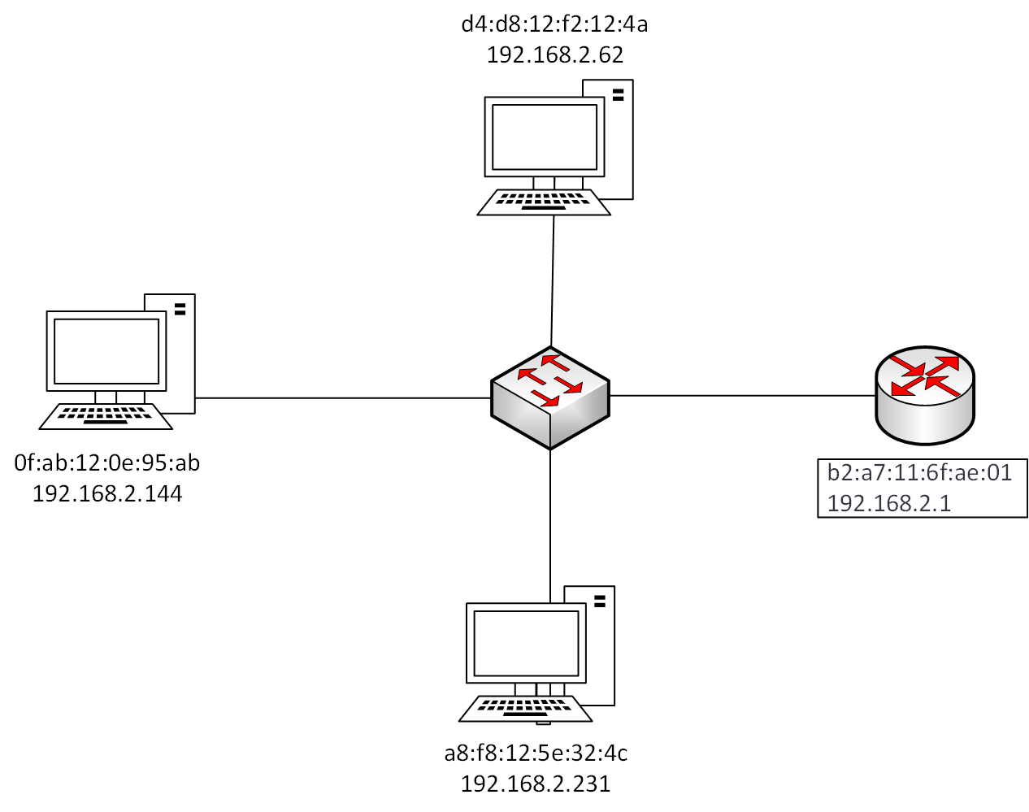
IP Source Guard
IP source guard checks all IP packets against the DHCP Snooping database
The source IP of each IP packet is inspected. If the IP-MAC-port mapping doesn’t match the database, the packet is dropped.
Src = 192.168.2.144
Dst = 192.168.2.62

Slide 11
IP Source Guard configuration
user@switch1> show configuration vlans default
vlan-id 1;
forwarding-options {
dhcp-security {
ip-source-guard;
group trusted {
overrides {
trusted;
}
interface ge-0/0/0;
}
group untrusted {
interface ge-0/0/1;
interface ge-0/0/2;
}
}
Src = 192.168.2.144
Dst = 192.168.2.62

